Slide 1


Internship Project Presentation
A Field-Based Assessment of Welfare Activity Challenges
Shiri Ram Darbar Trust
STUDENT Shivesh Sharma
ROLL NUMBER 25SCS1003001052
PROGRAM B.Tech Computer Science & Engineering
UNIVERSITY IILM University, Greater Noida, U.P.
ORGANIZATION Shiri Ram Darbar Trust
SUPERVISOR Mr. Neeraj Sharma

Slide 2
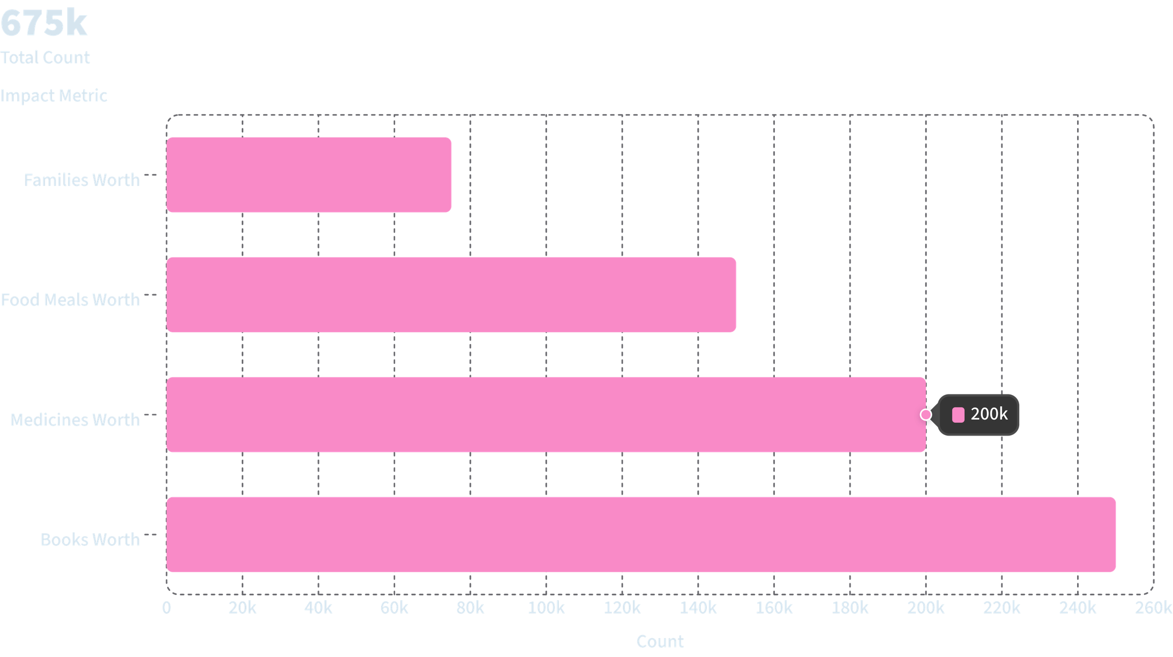
Shri Ram Darbar Trust, Muzaffarnagar
June 4 - July 5, 2026
Shri Ram Darbar Trust is a non-governmental organization based in Muzaffarnagar, Uttar Pradesh, dedicated to serving the underprivileged and vulnerable members of society. The Trust operates with a mission to provide essential support — including food, clothing, and blankets — to those in need, while also extending care to animals through its dedicated programs and dairy farm.

Slide 3
Providing Clothes & Blankets
One of the core initiatives of Shri Ram Darbar Trust is the distribution of clothes and blankets to people in need. The Trust collects and distributes warm clothing and blankets, especially during the winter months, to ensure that no one in the community is left without protection from the cold. This program reaches out to the most vulnerable — including the elderly, children, and families living in poverty — providing them with dignity and comfort through essential clothing support.

Slide 4
Food Distribution Program
Our Mission
Who We Serve
Ensuring that no one in our community goes to bed hungry. The Trust regularly organizes food distribution drives to provide nutritious meals to those who need them most.
Low-income families
Elderly individuals without support
Children from underprivileged backgrounds
Homeless and displaced persons
Through its food distribution program, Shri Ram Darbar Trust works to address hunger and malnutrition in the Muzaffarnagar region, providing regular meals and food supplies to those who struggle to meet their daily nutritional needs.

Slide 5
Animal Care & Dairy Farm
Shri Ram Darbar Trust also extends its compassion beyond human welfare to include the care of animals. The Trust operates a dairy farm that serves a dual purpose — it supports the Trust's food distribution efforts by providing fresh milk and dairy products, and it offers a safe, nurturing environment for the animals in its care.
The dairy farm is managed with care and attention, ensuring that the animals are healthy, well-fed, and treated with kindness. This initiative reflects the Trust's holistic approach to community welfare, recognizing that the well-being of animals is closely tied to the well-being of the people who depend on them.

Slide 6
Research Internship Overview
During the internship period from June 4, 2026 to July 5, 2026, the role of Research Intern at Shri Ram Darbar Trust involved observing, documenting, and understanding the various programs and operations of the Trust. As a researcher, the intern engaged with the Trust's activities by telling them and seeing all the stuff — gaining firsthand experience of how a grassroots NGO functions on a day-to-day basis.
Duration
Role
Organization
June 4, 2026 – July 5, 2026
Research Intern
Shri Ram Darbar Trust, Muzaffarnagar

Slide 7
Research Activities & Observations
As a Research Intern, the work involved closely observing and documenting the Trust's operations across its various programs. This included visiting the dairy farm, witnessing food and clothing distribution drives, and understanding how the Trust manages its resources and volunteers to serve the community effectively.
Observing Programs
Documenting Operations
Community Engagement
Watching and learning about the food distribution, clothing drives, and animal care activities firsthand.
Recording how the Trust manages its dairy farm, volunteer coordination, and resource allocation.
Interacting with beneficiaries and volunteers to understand the real-world impact of the Trust's work.

Slide 8
Impact of the Trust's Work
Clothes & Blankets
Food Support
Animal Welfare
Providing warm clothing and blankets to vulnerable families, especially during harsh winter months in Uttar Pradesh.
Regular food distribution ensuring that no member of the community goes hungry, with a focus on nutritious meals.
Caring for animals through a dedicated dairy farm that supports both the Trust's operations and the local community.

Slide 9
Key Learnings from the Internship
Understanding NGO Operations
Real-World Research Experience
The internship provided a deep understanding of how a grassroots NGO like Shri Ram Darbar Trust operates — from resource management and volunteer coordination to program delivery and community outreach.
By telling them and seeing all the stuff, the Research Intern gained practical, on-the-ground experience that goes beyond textbook knowledge — observing the challenges and rewards of community service work firsthand.

Slide 10

Conclusion
Shri Ram Darbar Trust, Muzaffarnagar, stands as a beacon of hope and compassion in the community. Through its dedicated efforts in providing clothes, blankets, and food to those in need, and through its commitment to animal care via its dairy farm, the Trust demonstrates what it means to serve with heart and purpose.
This internship offered a valuable opportunity to witness and document this meaningful work — contributing to a deeper understanding of grassroots social impact and the power of community-driven change.
This presentation was created as part of the Research Internship at Shri Ram Darbar Trust, Muzaffarnagar — June 4, 2026 to July 5, 2026.

